Slide 1
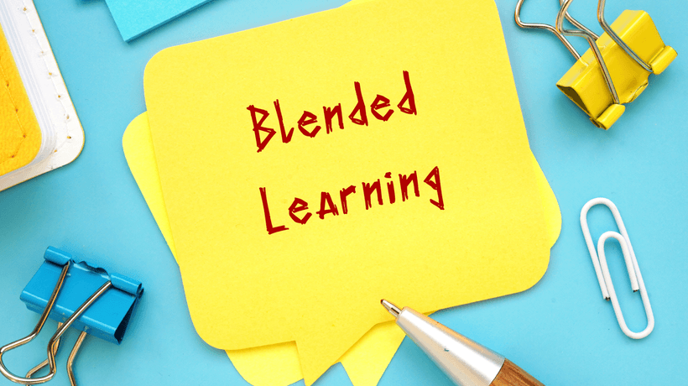
Presented by-
Kingshuk Karan
Dept. of Education
Mugberia Gangadhar Mahavidyalaya

Slide 2
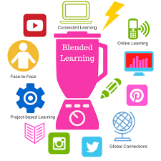
Blended Learning

Slide 3
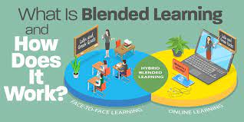
Blended learning is an approach to learning that combines face-to-face and online learning experiences.
Ideally, each (both online and off) will complement the other by using its particular strength.

Slide 4
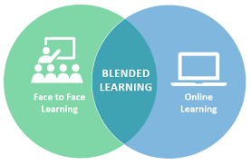
Blended Learning

Slide 5
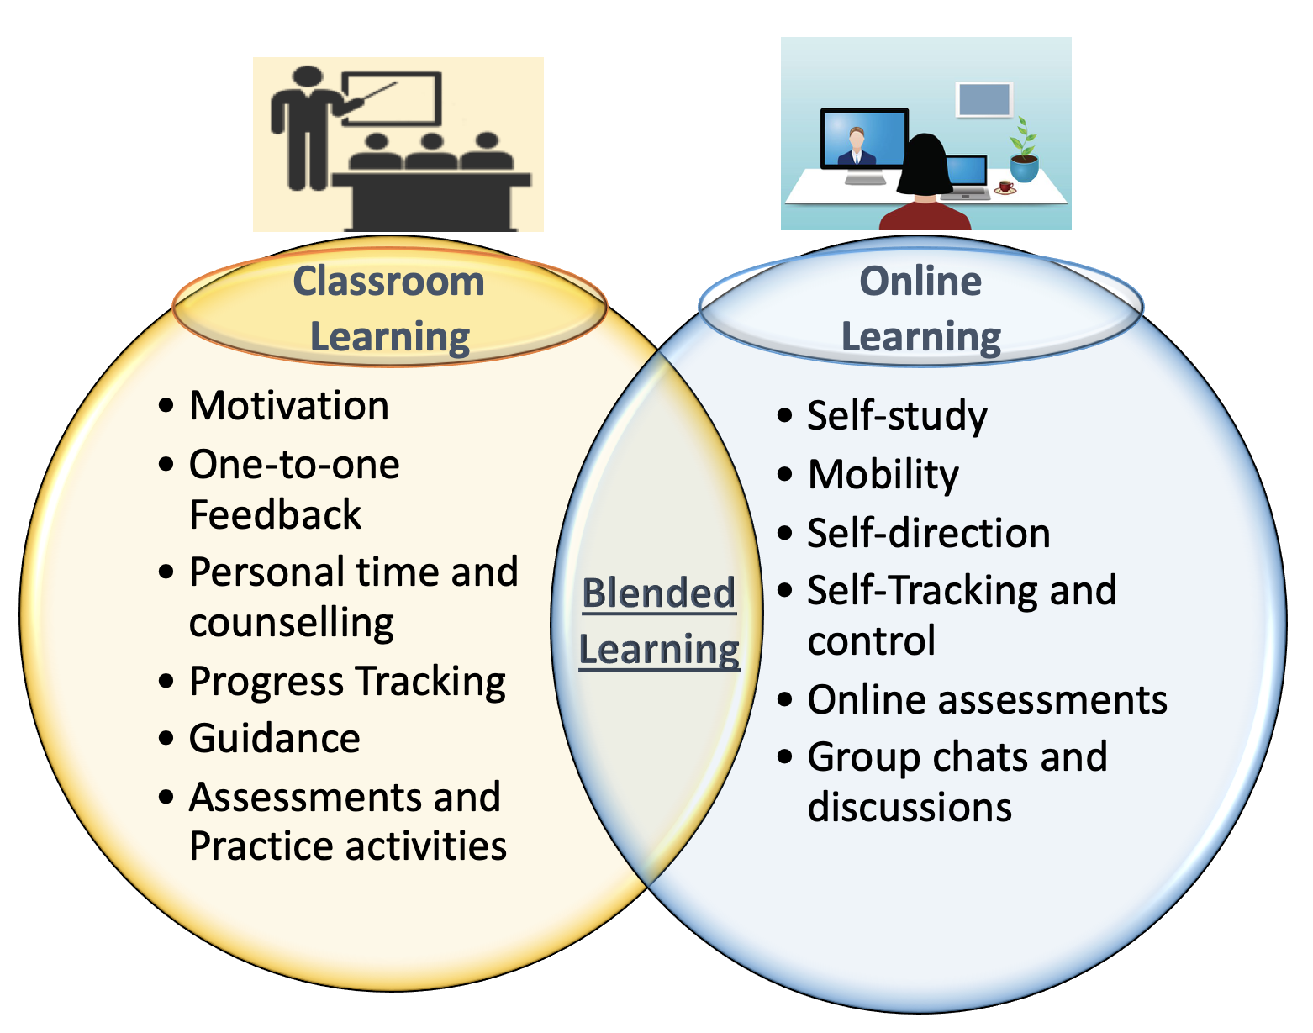
Blended learning

Slide 6
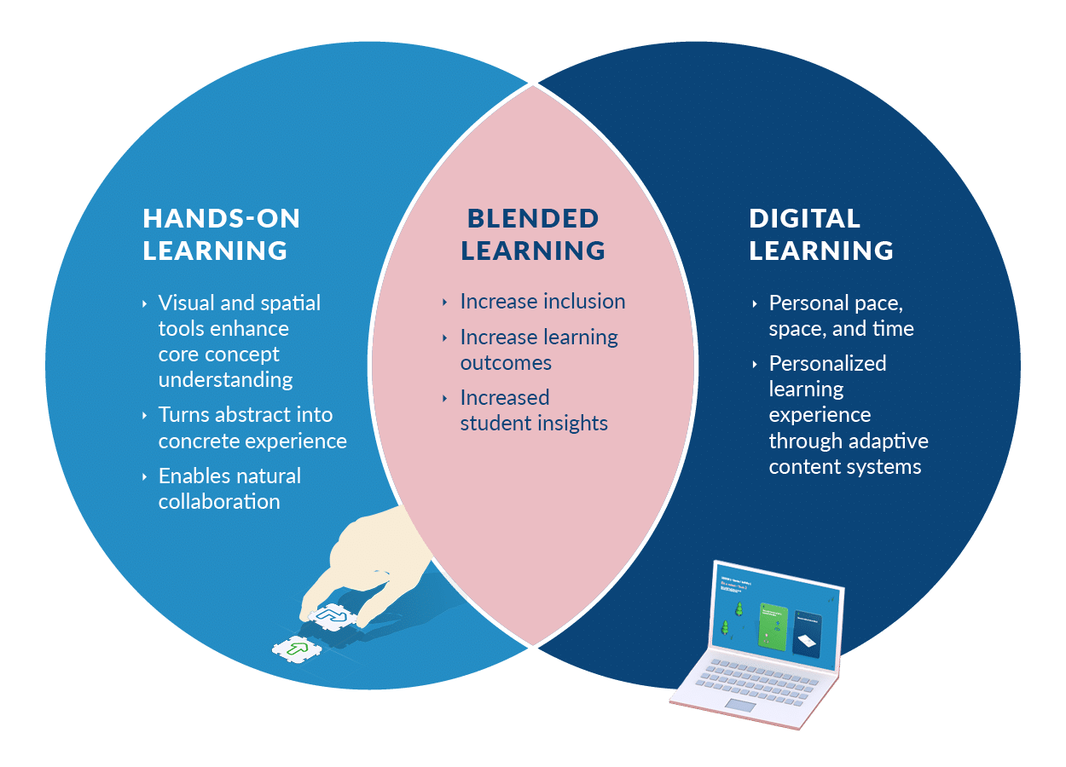
Blended Learning

Slide 7
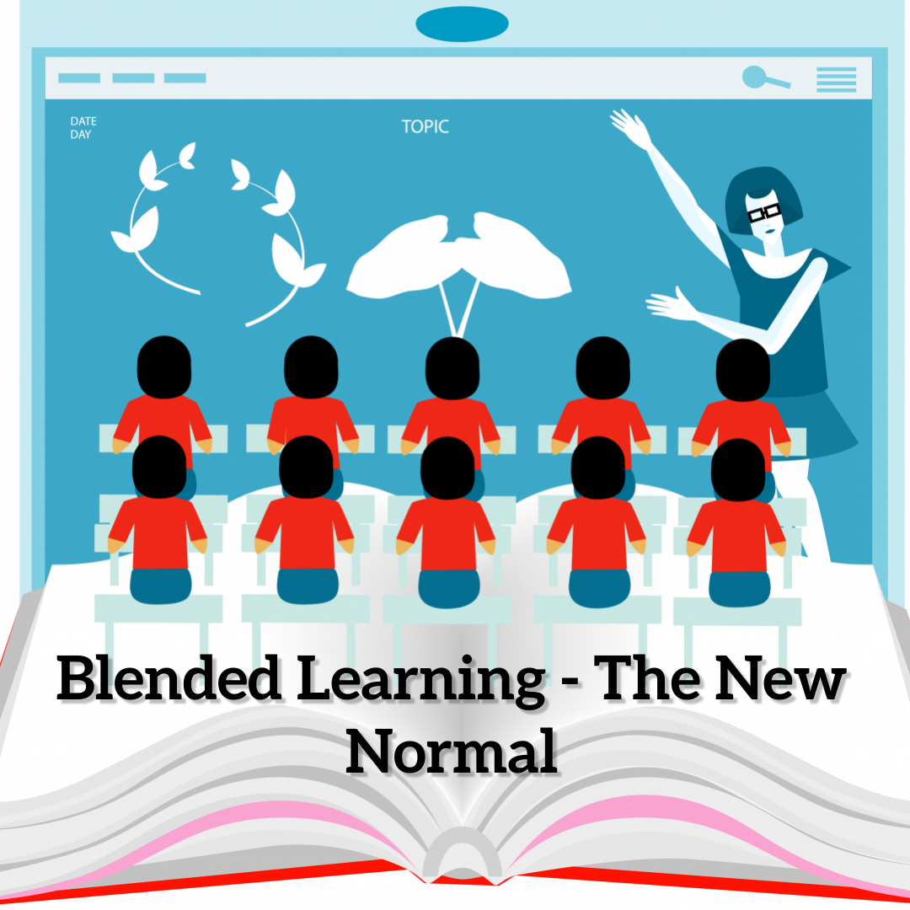

Slide 8
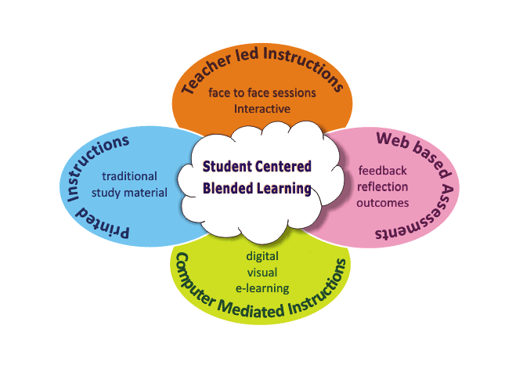
Blended Learning

Slide 9
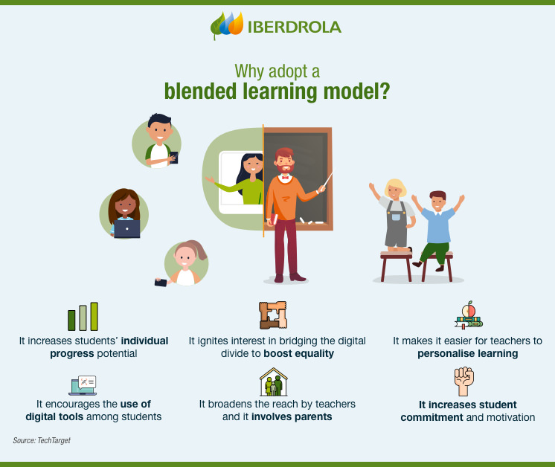

Slide 10
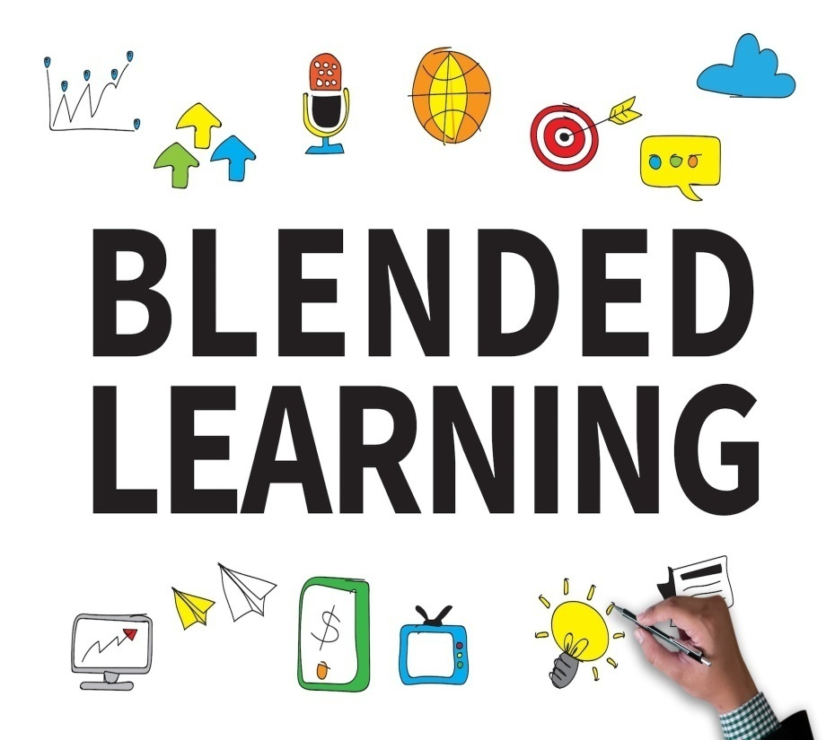
Key Benefits of Blended Learning
Cost efficient
Time-saving
Increases ROI
Flexible schedule
Learner engagement
Streamlined evaluations
24/7 accessibility
Collaboration
Personalized learning

Slide 11
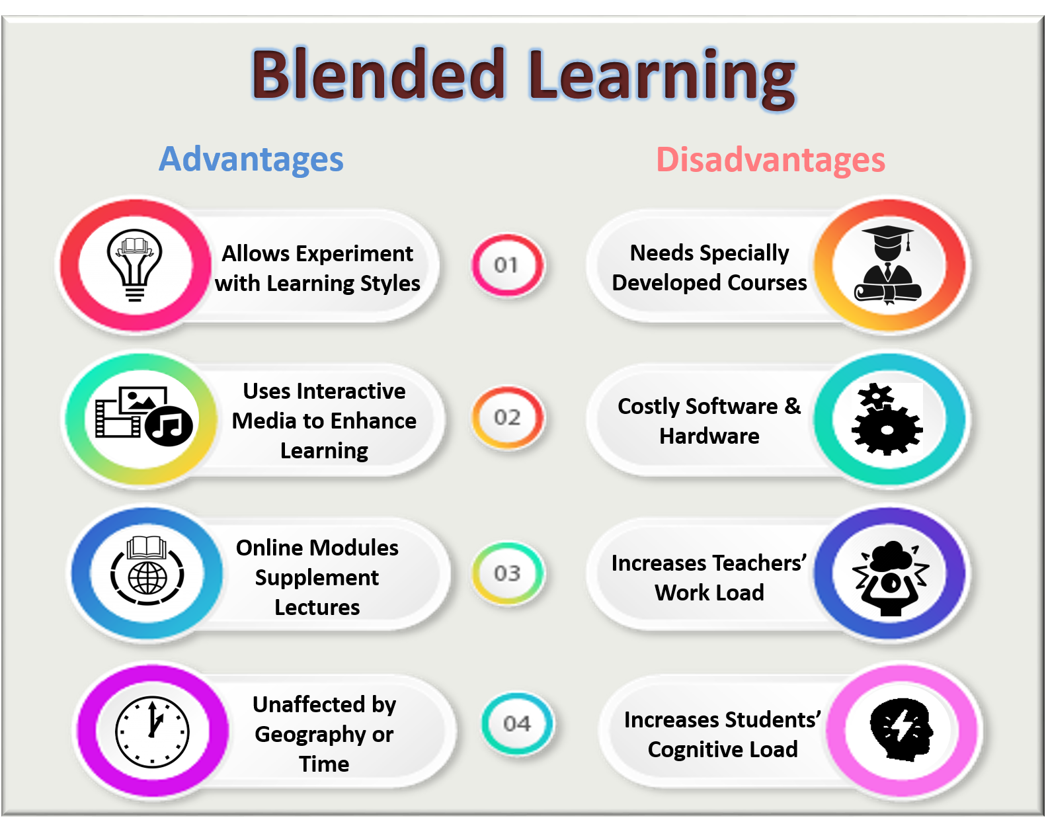

Slide 12
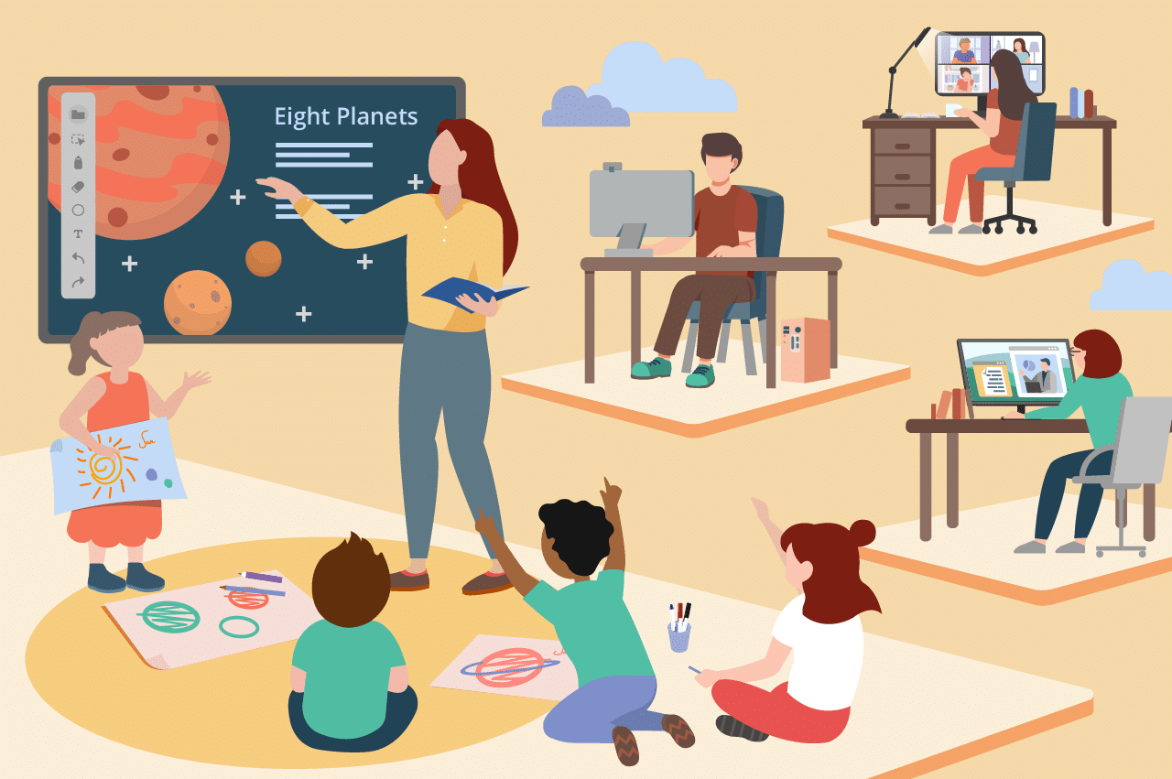
How to use Blended Learning?
Formulate your blended learning goals in advance.
Combine online & face-to-face instruction.
Define your core learning objectives and goals.
Specify how and when technology will be used.
Create learning activities that offer the best of both worlds.

Slide 13
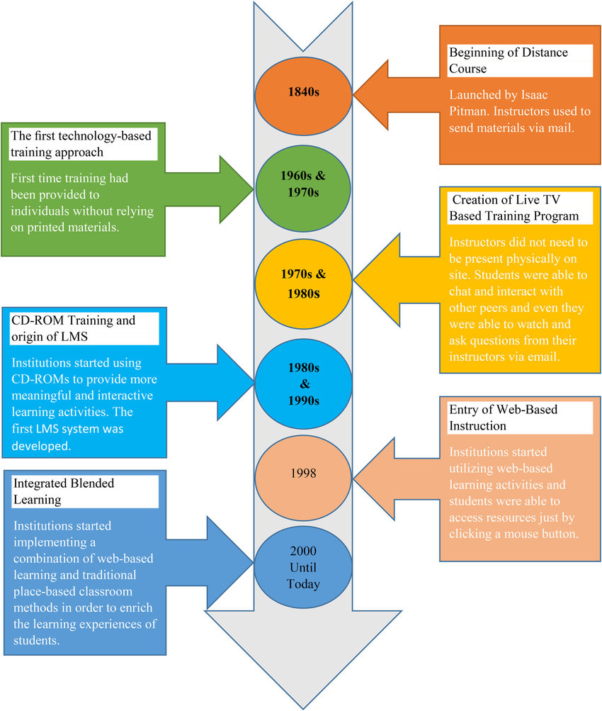
Blended Learning

Slide 14
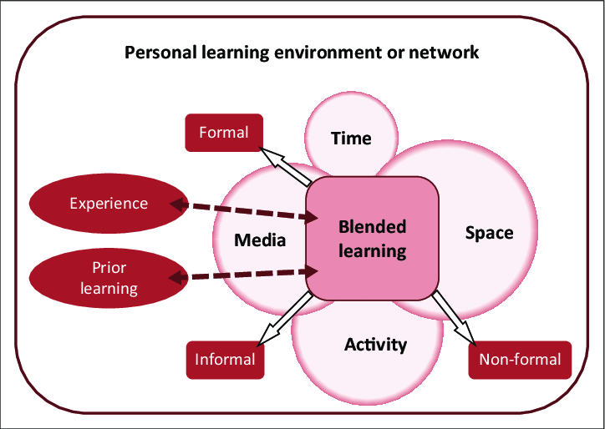

Slide 15
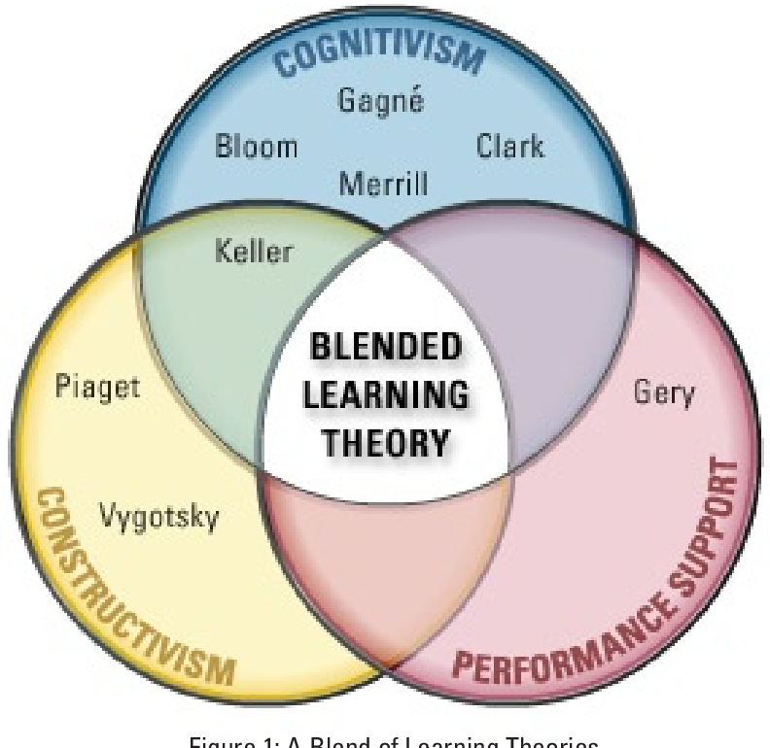
Blended Learning Theory

Slide 16
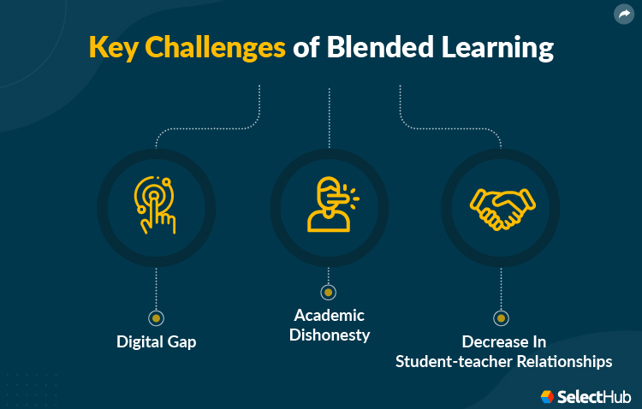

Slide 17
Blended Learning
Conclusion:
Blended learning can be the best of both worlds, and through a significant undertaking, once implemented successfully, such a program has significant benefits for the organization and employees.

Slide 18
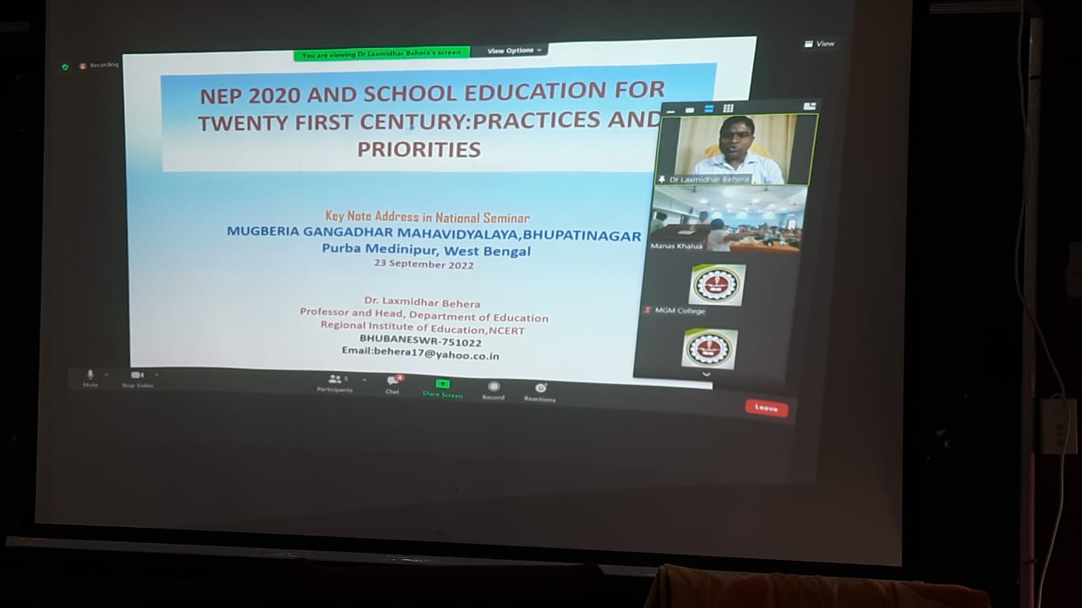
A blended mode of Seminar organized by Dept. of Education, MGM.

Slide 19
THANK YOU

